Slide 1
Electronics Systems (938II)
Lecture 3.2
Semiconductor Memories – ROM and PROM

Slide 2
ROM*
ROM = Read-Only Memory
However, this gives information only on the supported operation(s)
I.e., read-only (not write)
It does not give information on the access mode (random or sequential)
Typically, this kind of memories supports random access
I.e., any arbitrary address can be accessed immediately
So, it is also a RAM
Please, do not confuse with the computer memory typically called RAM, which is a RAM (from the perspective of access mode), but it is also a RWM (Read-Write Memory)

Slide 3



ROM – Architecture*
Brief reminder of the structure of semiconductor memories
$WL_{i}$ = Word Line
$BL_{j}$ = Bit Line
$$WL_{i}$$
$$BL_{j}$$

Slide 4


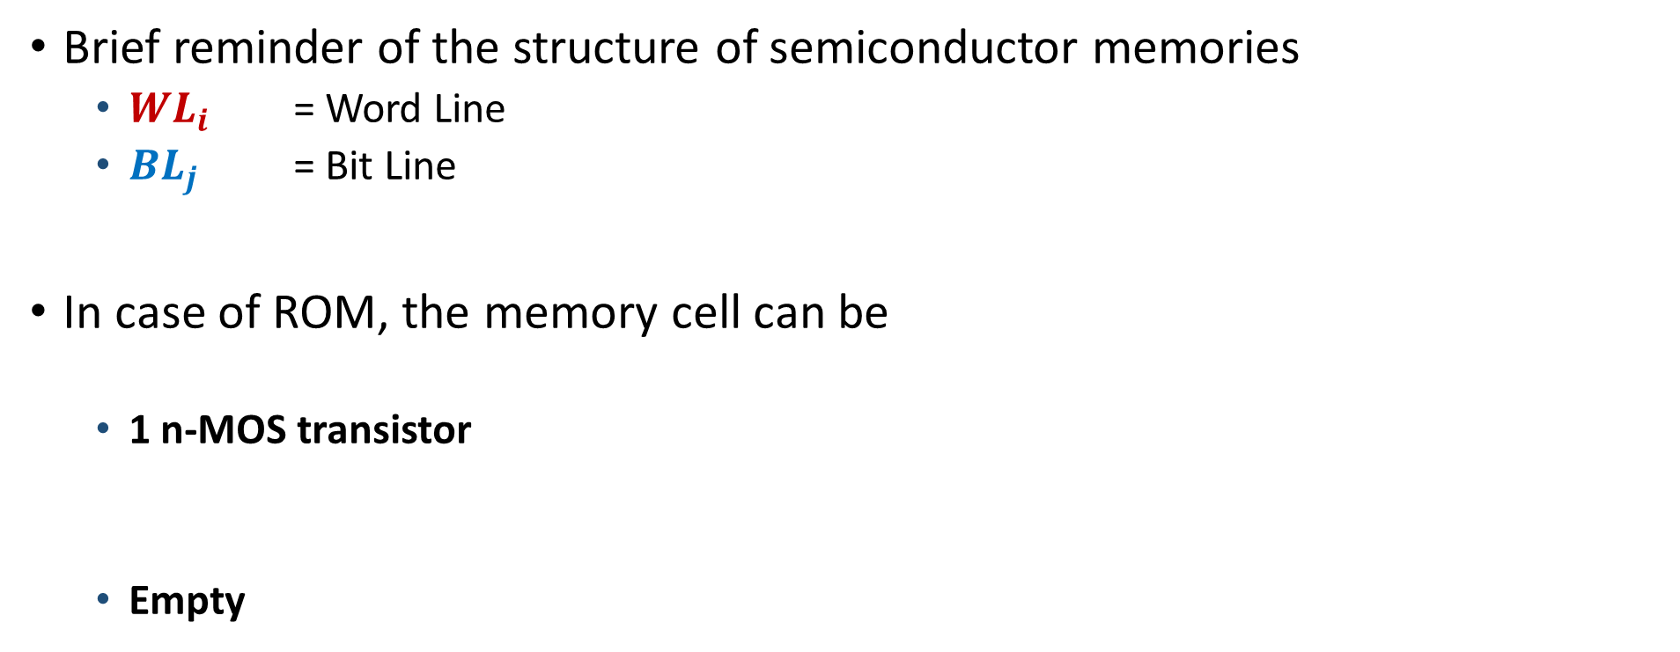
ROM – Architecture*
Brief reminder of the structure of semiconductor memories
$WL_{i}$ = Word Line
$BL_{j}$ = Bit Line
In case of ROM, the memory cell can be
1 n-MOS transistor
Empty
$$WL_{i}$$
$$BL_{j}$$

Slide 5

ROM – Architecture*
Memory cell – n-MOS transistor
$WL_{i}$ = Word Line
$BL_{j}$ = Bit Line
n-MOS
D = Drain
G = Gate
S = Source
$$WL_{i}$$
$$BL_{j}$$

Slide 6

ROM – Architecture*
Memory cell – n-MOS transistor
$WL_{i}$ = Word Line
$BL_{j}$ = Bit Line
n-MOS
D = Drain
G = Gate
S = Source
To complete the architecture …
$$WL_{i}$$
$$BL_{j}$$

Slide 7

ROM – Architecture*
Memory cell – n-MOS transistor
$WL_{i}$ = Word Line
$BL_{j}$ = Bit Line
n-MOS
D = Drain
G = Gate
S = Source
R = Resistor
Pull-up resistor: connect $BL_{j}$ to V_{CC} = high logic level (1)
$$WL_{i}$$
$$BL_{j}$$

Slide 8
ROM – Architecture*
Memory cell – n-MOS transistor
Principle of operation
$$WL_{i}$$
$$BL_{j}$$

Slide 9

ROM – Architecture*
Memory cell – n-MOS transistor
Principle of operation
$WL_{i}$ = 0
n-MOS = OFF (open circuit)
$BL_{j}$ = 1 (because of pull-up resistor)
$$WL_{i}$$
$$BL_{j}$$

Slide 10

ROM – Architecture*
Memory cell – n-MOS transistor
Principle of operation
$WL_{i}$ = 0
n-MOS = OFF (open circuit)
$BL_{j}$ = 1 (because of pull-up resistor)
$WL_{i}$ = 1
n-MOS = ON (short circuit)
$BL_{j}$ = 0 (ground connection through the n-MOS)
$$WL_{i}$$
$$BL_{j}$$

Slide 11


ROM – Architecture*
Memory cell – Empty
Principle of operation
$WL_{i}$ = 0
$BL_{j}$ = 1 (because of pull-up resistor)
$WL_{i}$ = 1
$BL_{j}$ = 1 (because of pull-up resistor)
$$WL_{i}$$
$$BL_{j}$$

Slide 12
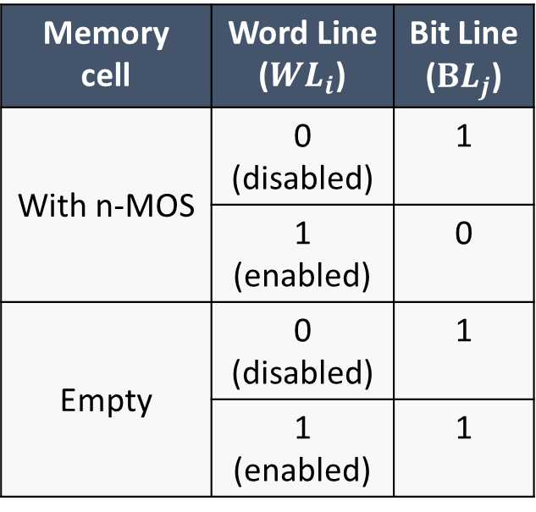
ROM – Architecture*
Memory cell – Summary
Principle of operation
Memory cell | Word Line ($WL_{i}$) | Bit Line ($BL_{j}$)
With n-MOS | 0 (disabled) | 1
 | 1 (enabled) | 0
Empty | 0 (disabled) | 1
 | 1 (enabled) | 1

Slide 13
ROM – Architecture*
Integrating the row and column decoders to complete the architecture

Slide 14
ROM – Architecture*
Integrating the row and column decoders to complete the architecture
Example on a 2x4 ROM
A = Address (3-bit)
Q = single-bit output

Slide 15







ROM – Architecture*
Integrating the row and column decoders to complete the architecture
Example on a 2x4 ROM
A = Address (3-bit)
Q = single-bit output
Assume cell (x,y)
$WL_{X}$
$BL_{y}$
$$WL_{0}$$
$$WL_{1}$$
$$BL_{0}$$
$$BL_{1}$$
$$BL_{2}$$
$$BL_{3}$$

Slide 16





ROM – Architecture*
Integrating the row and column decoders to complete the architecture
Example on a 2x4 ROM
A = Address (3-bit)
Q = single-bit output
Assume cell (x,y)
$WL_{X}$
$BL_{y}$
Assume to read cell (1,1)
$$WL_{0}$$
$$WL_{1}$$
$$BL_{0}$$
$$BL_{1}$$
$$BL_{2}$$
$$BL_{3}$$

Slide 17





ROM – Architecture*
Integrating the row and column decoders to complete the architecture
Example on a 2x4 ROM
A = Address (3-bit)
Q = single-bit output
Assume cell (x,y)
$WL_{X}$
$BL_{y}$
Assume to read cell (0,1)
$$WL_{0}$$
$$WL_{1}$$
$$BL_{0}$$
$$BL_{1}$$
$$BL_{2}$$
$$BL_{3}$$

Slide 18




ROM – Architecture*
Integrating the row and column decoders to complete the architecture
Example on a 2x4 ROM
A = Address (3-bit)
Q = single-bit output
Assume cell (x,y)
$WL_{X}$
$BL_{y}$
Assume to read cell (1,3)
$$WL_{0}$$
$$WL_{1}$$
$$BL_{0}$$
$$BL_{1}$$
$$BL_{2}$$
$$BL_{3}$$

Slide 19





ROM – Architecture*
Integrating the row and column decoders to complete the architecture
Example on a 2x4 ROM
A = Address (3-bit)
Q = single-bit output
Assume cell (x,y)
$WL_{X}$
$BL_{y}$
Assume to read cell (0,3)
$$WL_{0}$$
$$WL_{1}$$
$$BL_{0}$$
$$BL_{1}$$
$$BL_{2}$$
$$BL_{3}$$

Slide 20
ROM – Architecture*
So, when reading (i.e. enabling corresponding word line and bit line) a memory cell
With (n-MOS) transistor → Output = 0
Empty (without transistor) → Output = 1
However, also solutions with active-low decoding logic (for column decoder) exist

Slide 21
ROM – Architecture*
Active-low decoding logic (column decoder)
Example on a 2x4 ROM

Slide 22

ROM – Architecture*
Active-low decoding logic (column decoder)
Example on a 2x4 ROM
Assume to read cell (0,3)
$$WL_{0}$$
$$WL_{1}$$
$$BL_{0}$$
$$BL_{1}$$
$$BL_{2}$$
$$BL_{3}$$

Slide 23
ROM – Architecture*
When reading a memory cell when column decoder is active-low
With (n-MOS) transistor → Output = 1
Empty (without transistor) → Output = 0
The opposite of the previous case

Slide 24
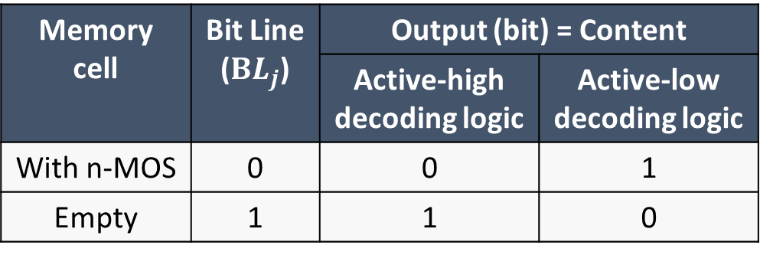
ROM – Architecture*
Content of memory cells
The output (bit) corresponds to the content of memory cells, since that is what is obtained by reading that cell
Memory cell | Bit Line ($BL_{j}$) | Output (bit) = Content
 |  | Active-high decoding logic | Active-low decoding logic
With n-MOS | 0 | 0 | 1
Empty | 1 | 1 | 0

Slide 25
ROM – Remarks and applications*
The one shown is called also mask-ROM
Remember about the photolithographic masks employed in the semiconductor manufacturing process
Each memory content corresponds to a different layout (of transistors), or, in other words, to a different integrated circuit
Thus, to a different mask to realize that layout (or circuit)

Slide 26
ROM – Remarks and applications*
Photolithographic masks have high costs
Only for applications that require high volumes of ROM
Memory content cannot be modified
The modification of just one bit (due to updates or bugs) means wasting the entire chip (and all other chips with the same content)
Only for solid applications for which you are largely sure about the content of the memory

Slide 27
PROM*
In the course of technological progress, mask-ROM has evolved into Programmable ROM (PROM)
Still a ROM, Read-Only Memory
But whose content is defined after the manufacture (of the integrated circuit)
Not during the manufacture like the mask-ROM
This allowed for a reduction in production costs because …
For mask-ROMs: different memory content → different integrated circuit → different production line (masks, …)
For PROM: always the same integrated circuit → the same production line

Slide 28
PROM*
So, after production the PROM must be “written” to define its content
This operation is called Programming
From here the name
Just one time
OTP = One Time Programmable

Slide 29
PROM*
So, after production the PROM must be “written” to define its content
This operation is called Programming
From here the name
Just one time
OTP = One Time Programmable
For this purpose, each memory cell contains a transistor + a fuse
The fuse is an electronic component that …
… by default, is a connection (a short circuit)
… when subjected to a very strong current, it breaks down, breaking the connection (it becomes an open circuit)

Slide 30
PROM – Architecture*
Memory cell

Slide 31


PROM – Architecture*
Memory cell
Transistor (n-MOS)

Slide 32


PROM – Architecture*
Memory cell
Transistor (n-MOS)
Fuse

Slide 33
PROM – Architecture*
Memory cell
Transistor (n-MOS)
Fuse
(default)

Slide 34
PROM – Architecture*
Memory cell
Transistor (n-MOS)
Fuse
(default)
(after high current flow)

Slide 35
PROM – Principle of operation*
Thus, programming means selecting which fuses to break (by injecting a high current)
Programmed fuse = broken fuse = open circuit
Unprogrammed fuse = default-state fuse = short circuit

Slide 36
PROM – Principle of operation*
For this purpose, high voltage pulses (V_{PP} = 10/30 V) must be applied to
Gate terminal of n-MOS = Word Line
Drain terminal of n-MOS = Bit Line
n-MOS is in “high conduction” region = very high current
V_{PP}
V_{PP}
V_{PP}
V_{PP}

Slide 37
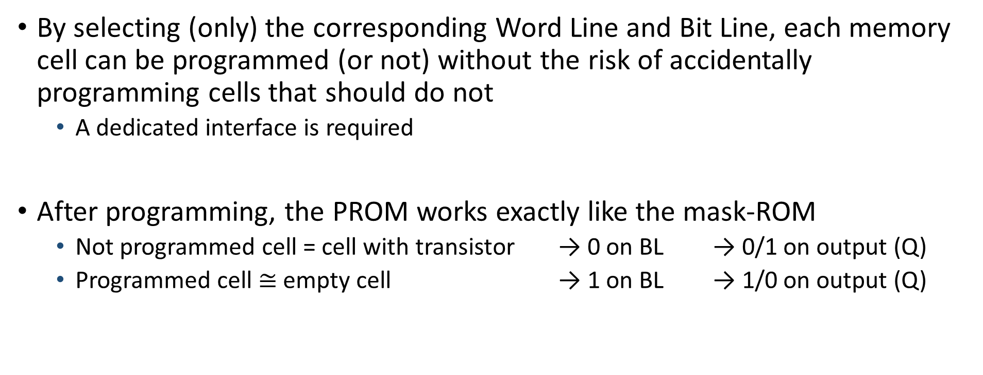
PROM – Principle of operation*
By selecting (only) the corresponding Word Line and Bit Line, each memory cell can be programmed (or not) without the risk of accidentally programming cells that should do not
A dedicated interface is required
After programming, the PROM works exactly like the mask-ROM
Not programmed cell = cell with transistor → 0 on BL → 0/1 on output (Q)
Programmed cell $≅$ empty cell → 1 on BL → 1/0 on output (Q)

Slide 38
PROM – Principle of operation*
Example
Before programming

Slide 39
PROM – Principle of operation*
Example
After programming

Slide 40







PROM – Principle of operation*
Example
Reading cell (0,2)
$$WL_{0}$$
$$WL_{1}$$
$$BL_{0}$$
$$BL_{1}$$
$$BL_{2}$$

Slide 41
PROM – Remarks and applications*
Anti-fuses can be used instead of fuses
Opposite of fuse
Default (not programmed) = open circuit
Programmed (with high current flow) = short circuit
Early PROMs had reliability problems
Incompletely vaporized fuses
Floating shrapnel inside the IC package
Target applications
The same as mask-ROMs

